Slide 1
Continuum of Care
Jackson/West Tennessee CoC-TN-507
Rozann Downing, Planning

Slide 2
Defining Continuum of care
A Continuum of Care (CoC) is a regional or local planning body that coordinates housing and services funding for homeless families and individuals. According to HUD, a CoC is “a community plan to organize and deliver housing and services to meet the specific needs of people who are homeless as they move to stable housing and maximize self-sufficiency. It includes action steps to end homelessness and prevent a return to homelessness.” It is designed to promote the following:
Communitywide commitment to the goal of ending homelessness;
Funding for efforts by nonprofit providers, and state and local governments to quickly re- house homeless individuals and families while minimizing the trauma and dislocation caused to homeless individuals, families, and communities by homelessness;
Access to mainstream programs (employment, benefits, behavioral healthcare, etc.) by homeless individuals and families; and
Optimize self-sufficiency among individuals and families experiencing homelessness.

Slide 3

History of Jackson/west tn Coc
Began in 2002 as West TN Housing Resource Coalition
Strength is that area non-profits collaborated to address homelessness in West Tennessee (including Stewart, Houston, and Humphreys)
Collaborative Applicant has changed 3 times in the past 6 years-currently Jackson-Madison County General Hospital
TN-507 incorporated in 2019 to be able to become the Collaborative Applicant, if needed
We currently have 21 CoC projects & $3.3M renewals

Slide 4

community
Notes:
One way to define community is: It is a small or large social unit that has something in common such as norms, religion, values, or identity! The people sitting in this room not only make up the CoC membership, but also a community that meets this definition as we are all working together to help others.

Slide 5
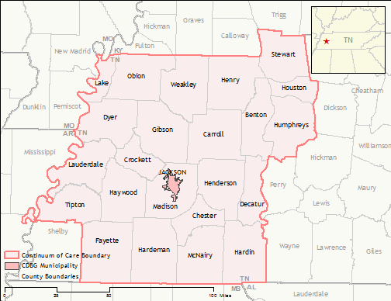
Our coc Service area

Slide 6
Jackson/West Tennessee Coc
The Jackson/West Tennessee CoC is dedicated to streamlining and strengthening the current delivery system through even greater collaborative planning, partnership, and program execution.
The CoC is made up of Government entities, elected officials, non-profit organizations, financial institutions, businesses, churches, healthcare providers, homeless and formerly homeless, and others.
Notes:
The Board is actively recruiting new members; educators, housing developers, neighborhood associations, as well as the media. The broader our group is, the more people we can reach.

Slide 7
Coc vision
It is the vision of Jackson/West TN CoC to create a seamless, comprehensive system of services that:
Prevents and ends homelessness
Supports the emergency as well as ongoing supportive needs of the homeless and at-risk population.
Provides the tools necessary to sustain needs of the homeless and at-risk population
Leads to permanent self-sufficiency.

Slide 8
Current coc programs
Supportive Housing Programs
Rental Assistance Programs (formerly S+C)
Homeless Management Information System
Rapid Rehousing
Coordinated Entry
Housing Navigators
Homeless Hotline/CoC Website w/ “Need Help Button”
Youth Homeless Demonstration Program
Emergency Motel Vouchers (New)

Slide 9
Areas of increased focus
Increasing affordable housing opportunities-New Bonus Projects (Tiny Homes)
Strengthening prevention and diversion practices.-Housing Navigation
Creating solutions for unsheltered homelessness.-Tent Encampments Outreach
Tailoring strategies for rural communities-New Project for Motel Vouchers
Increase awareness of youth homelessness-New YHDP funding
Learning from the expertise of people with lived experiences of homelessness.
Notes:
1. Partnering with housing developers. 2. Becoming more aware of differing worldviews. 5. Community wide life skill classes to enable people to cook, budget, childcare, etc.

Slide 10
Structure for plan
Became a 501c3 for Jackson/West Tennessee CoC, Inc.
Applied for a received Coordinating Entry Expansion Grant to have Housing Navigation
Applied for and received Youth Homeless Demonstration Program (YHDP) to provide homeless outreach & housing for homeless youth 18-24 years old
CoC does not apply for any CoC funding that another organization is willing to provide

Slide 11
QUESTIONS????
Please ask any questions you may have
Thank You

